Slide 1
Database Security

Slide 2
Objective of Database Security
The widespread use of multi-user database systems has increased productivity and efficiency for many organisations. However, it also exposes these organisations to a greater vulnerability of the databases being misused.
The overall objective of database security is to protect data in the databases against unauthorised use, disclosure, alteration, or destruction.

Slide 3
Database Security vs Integrity
They are two different concepts:
Database security
How to protect data from unauthorised use
  only authorised users are permitted to use the database; and
  they do so under the access control imposed by the system
Database integrity
How to ensure the accuracy or validity of data
  entity integrity, domain integrity, referential integrity rules
  other user-defined, application-specific integrity rules

Slide 4
Database Security vs Integrity
There are also common features between them:
  the database system must be aware of certain constraints that users must not violate;
  these constraints must be specified (by DBA) in some suitable language;
  these constraints must be maintained in the system catalogue;
  the DBMS must monitor user operations in order to ensure that the constraints are properly enforced.

Slide 5
Issues to be Considered
Legal, social ethical issues
e.g. whether a person has a legal right to access the information; Data Protection Act to ensure proper control of access to personal/confidential information
Policy issues
e.g. what is the company scheme to protect its database
Hardware issues
e.g. physical security of the computer system and the reliability of the hardware
Software issues
e.g. reliability of operating systems used

Slide 6
Issues to be Considered
Database specific concerns
Unauthorised use of the database, either deliberately or accidentally:
  Unauthorised users attempting access to the database
  Authorised users attempting unauthorized operations on certain data objects
Data encryption provides additional protection for sensitive data during transmission.

Slide 7
Access Request
In the context of database security, an access request / access right contains three aspects:
  user – who is requesting access
  operation – what operation is requested (select, insert, delete, update)
  data object – what data object is requested
Typically, users will have different access rights on various data objects in a database.

Slide 8
Granularity of Data Objects
Depending on the security schemes used, the scope of 'data objects' ranges from:
entire database,
a set of relations,
a set of tuples/columns,
a particular attribute value within a tuple.

Slide 9
Identification and Authentication
Authorisation subsystem: - provided by database security mechanism to check and verify users' identity for ensuring the security of the database against unauthorised access.
Before accessing the database a user must:
  identify themselves
  authenticate their identification
  additional identification and authentication may further be required during the session
  e.g. cash point, oracle log-in, finger-prints, retina scans, etc

Slide 10
Two Main Approaches
There are two main approaches to database security, depending on the type of objects (user or data) through which the access control is exercised:
Discretionary access control
    Control is exercised by assigning users different access rights on different data objects.
Mandatory access control
    Control is exercised by assigning data objects different classification levels and assigning users different clearance levels.

Slide 11
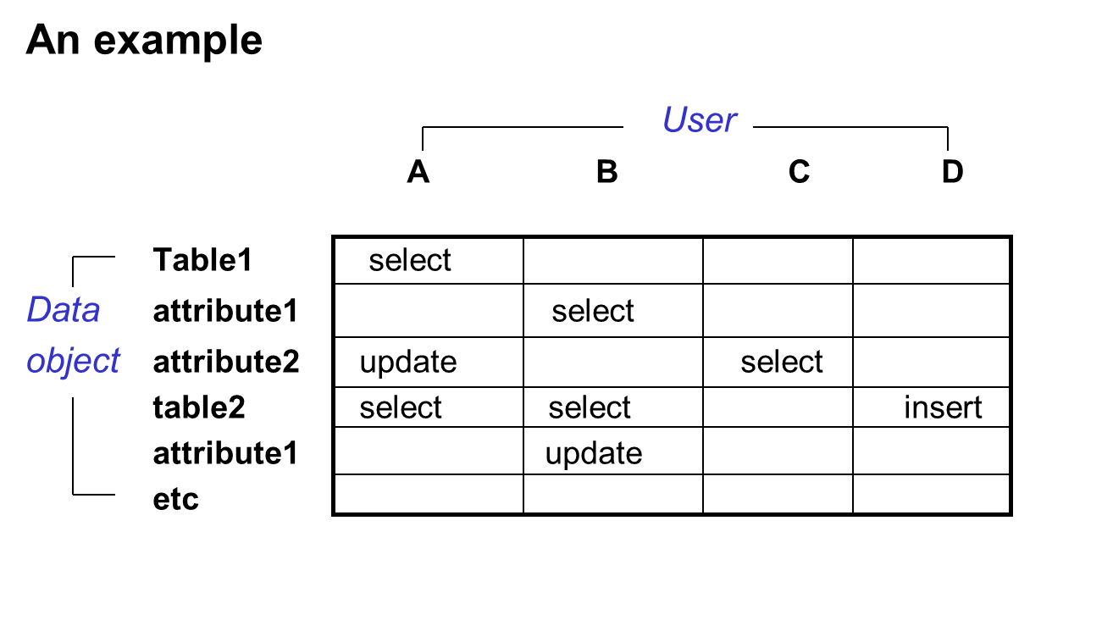
Access Matrix

Slide 12
Access Matrix
An access matrix may contain many 'empty' cells, so its information could be stored as user profiles, or object profiles:
User profiles (from the example):
user A table1:select; table1,atti2:update; table2:select
user B table1,attr1:select; table2:select; table2,attr1:update
etc
Object profiles (from the example)
table1 userA:select
table2 userA:select; userB:select; userD:insert
etc

Slide 13
Security Rules
Supported by SQL standard and facilitated by two statements GRANT and REVOKE:
GRANT - Definition of Security Rules
  GRANT operation
  ON data object
  TO user(s)
  violation response

Slide 14
Security Rules
Value-independent rules:
GRANT SELECT ON TABLE Employee
TO ELJ3FREDK; ELJ3PAULF, ELJ3STANG;
Value-dependent rules:
GRANT SELECT ON TABLE Supplier where Supplier-city = 'London'
TO JFG003356;
Context-dependent rules:
GRANT UPDATE ON TABLE Product
WHEN Day() in ('Mon', 'Tue', Wed', Thu', Fri')
AND Now() >= Time '09:00:00'
AND Now() <= Time '17:00:00'
TO Order-Dept;

Slide 15
Security Rules
Violation Response:
e.g. GRANT SELECT ON TABLE Employee
TO ELJ3FREDK
On attempted violation Reject;
REVOKE – Deletion of Security Rules
  REVOKE SELECT ON TABLE Employee TO ELJ3FREDK;
  REVOKE UPDATE ON TABLE Employee TO ELJ3FREDK;
  REVOKE DELETE ON TABLE Employee TO ELJ3FREDK;
  REVOKE INSERT ON TABLE Employee TO ELJ3FREDK;
  REVOKE SELECT, INSERT ON TABLE Employee TO ELJ3FREDK;
  REVOKE ALL ON TABLE Employee TO ELJ3FREDK;

Slide 16
Mandatory Control
Key Points of the scheme:
Each data object is assigned a classification level
Each user is assigned a clearance level
Users with a clearance level i can only access data object whose classification level j is lower than or equal to i.
The classification and clearance levels have the same number of possibilities
These levels form a strict ordering hierarchy

Slide 17
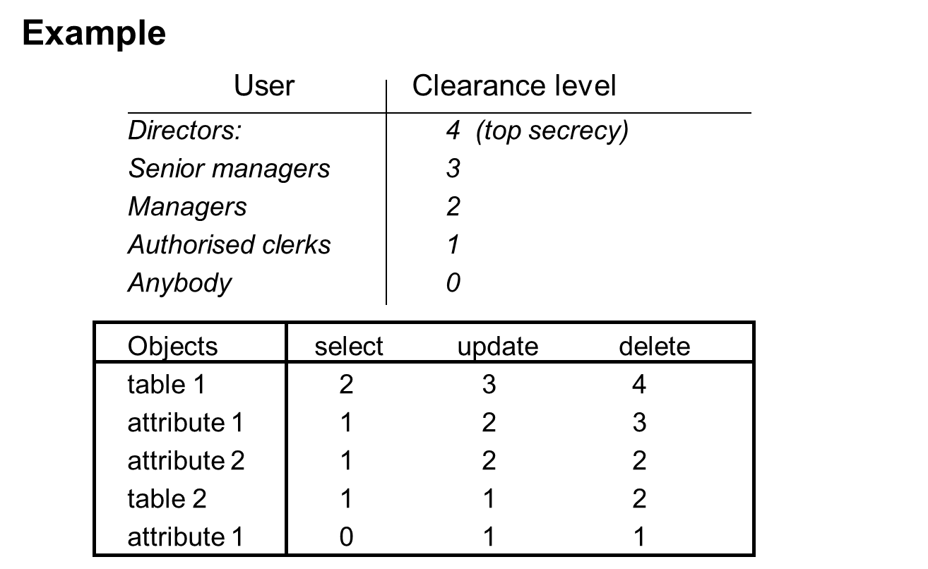
Security Classification Method

Slide 18
Security Classification Method
Questions:
According to the information given in the tables:
what is a manager's access right?
Is a manager allowed to delete a data item from the attribute 1 of Table 1?
Who can select attribute 1 of the Table 2?

Slide 19
Security Classification Method
Answers:
According to the information given in the tables:
what is a manager's access right?
    select tables 1 and 2;
    update table 2 and attributes 1 and 2 of table 1;
    delete table 2 and attribute 2 of table 1.
Is a manager allowed to delete a data item from the attribute 1 of Table 1?
    No
Who can select attribute 1 of Table 2?
Everyone!

Slide 20
Comparison
Discretionary control
more widely used due to its flexibility
supported by current SQL standard
Mandatory control approach
with more rigid structure
suitable for organisations with strict requirement for security and hierarchy (e.g. government, defence systems, for sensitive/classified information)

Slide 21
Summary
Objective of database security
Difference with database integrity
Issues of database security
Concept of access right/control/request
Two main approaches to security:
definition
methods and implementation
comparison

Slide 22
Bibliography
Connolly, T.M. &Begg, C.E., 2009. Database Systems: A Practical Approach to Design, Implementation and Management 5th ed., Addison Wesley. ISBN-0321523067
Date, C. J. 2004. An Introduction to Database Systems (8th ed.), Addison­Wesley, ISBN-0321197844

